Slide 1

Cody Schoenick

Slide 2
The Student’s Struggle
Memorization
Efficiency
Ease of use

Slide 3

Solution
Create flashcards
Load flashcards
Test knowledge

Slide 4
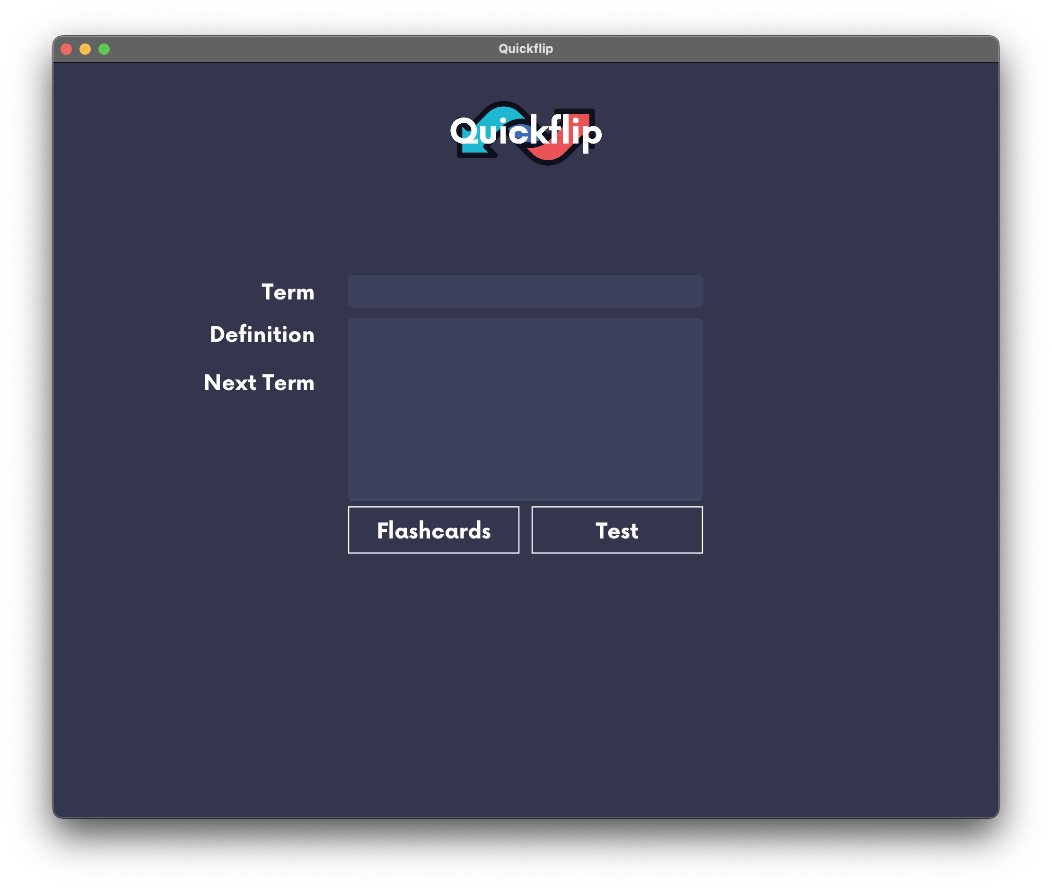
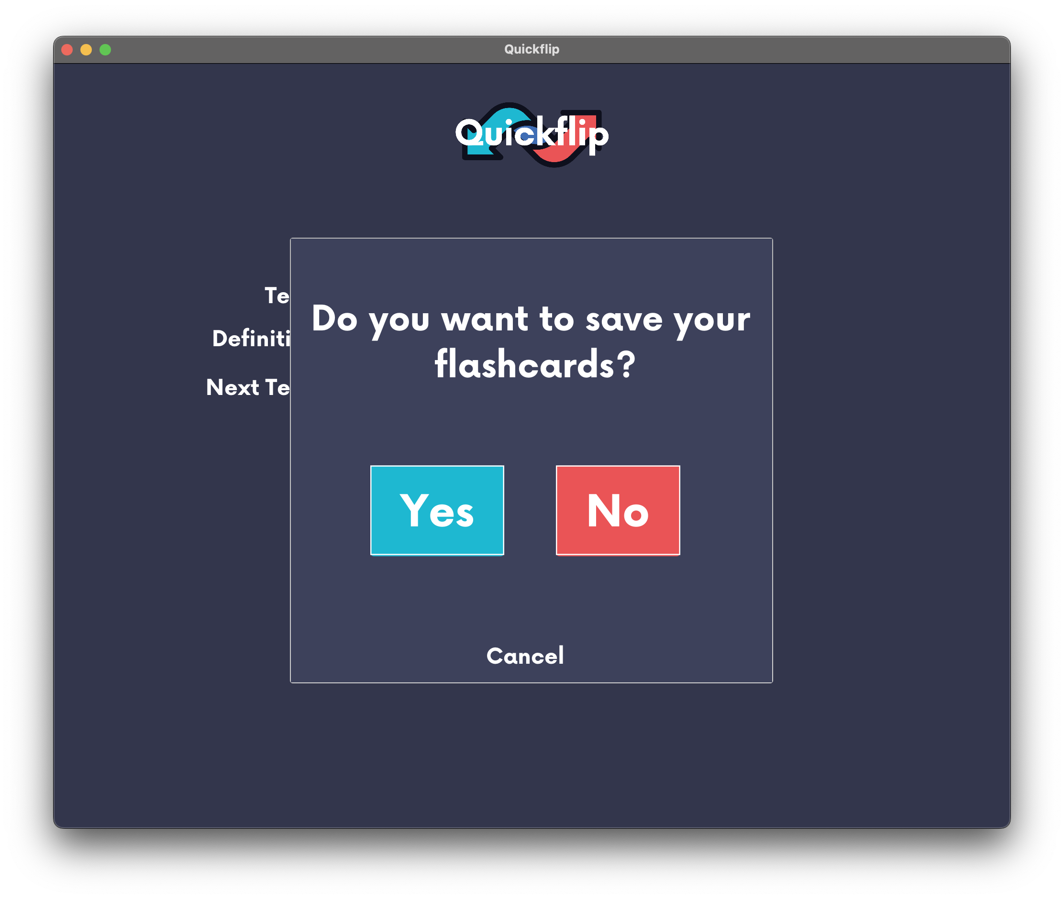
Create Flashcards

Slide 5
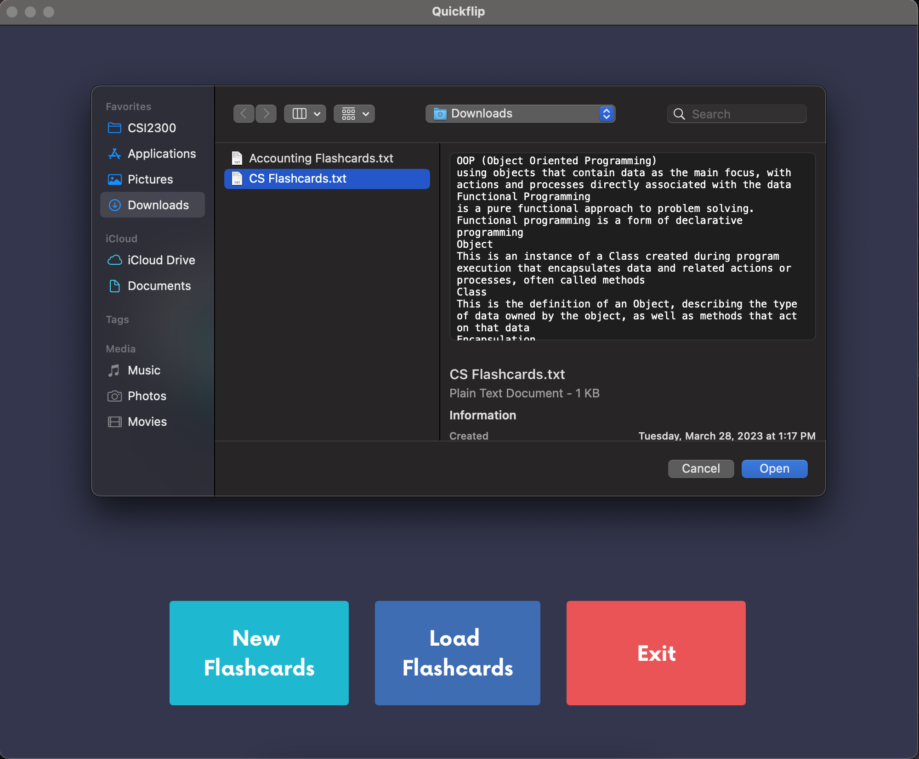
Load Flashcards

Slide 6
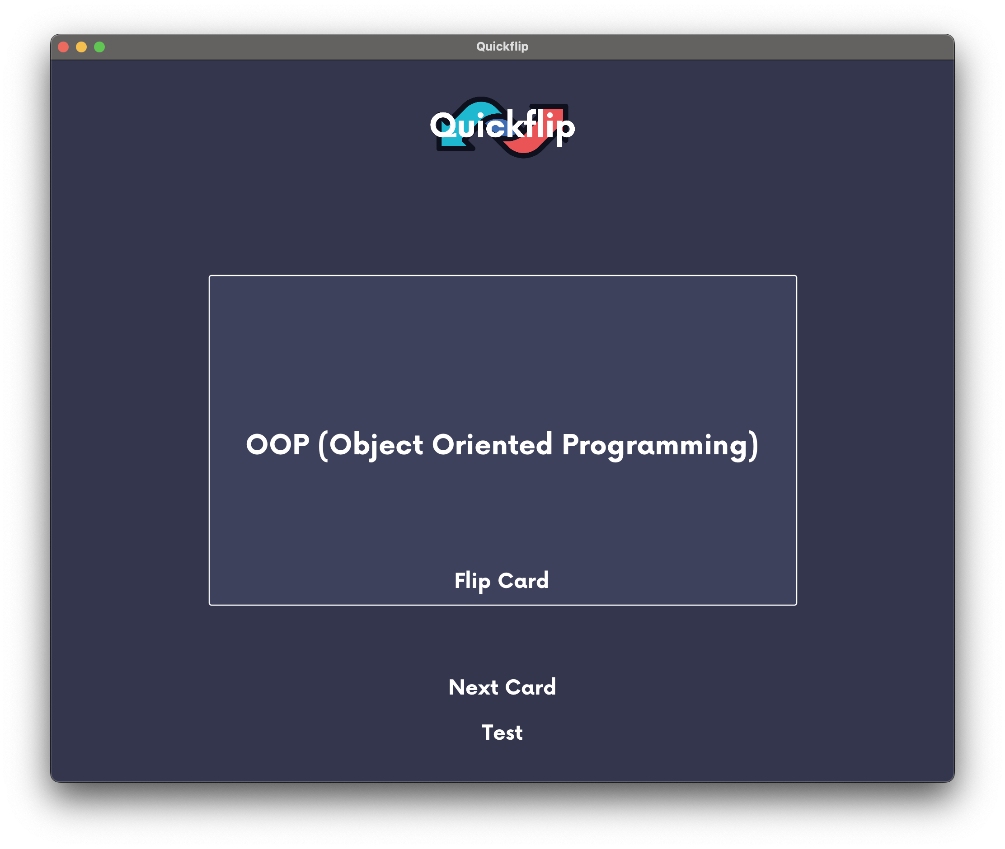
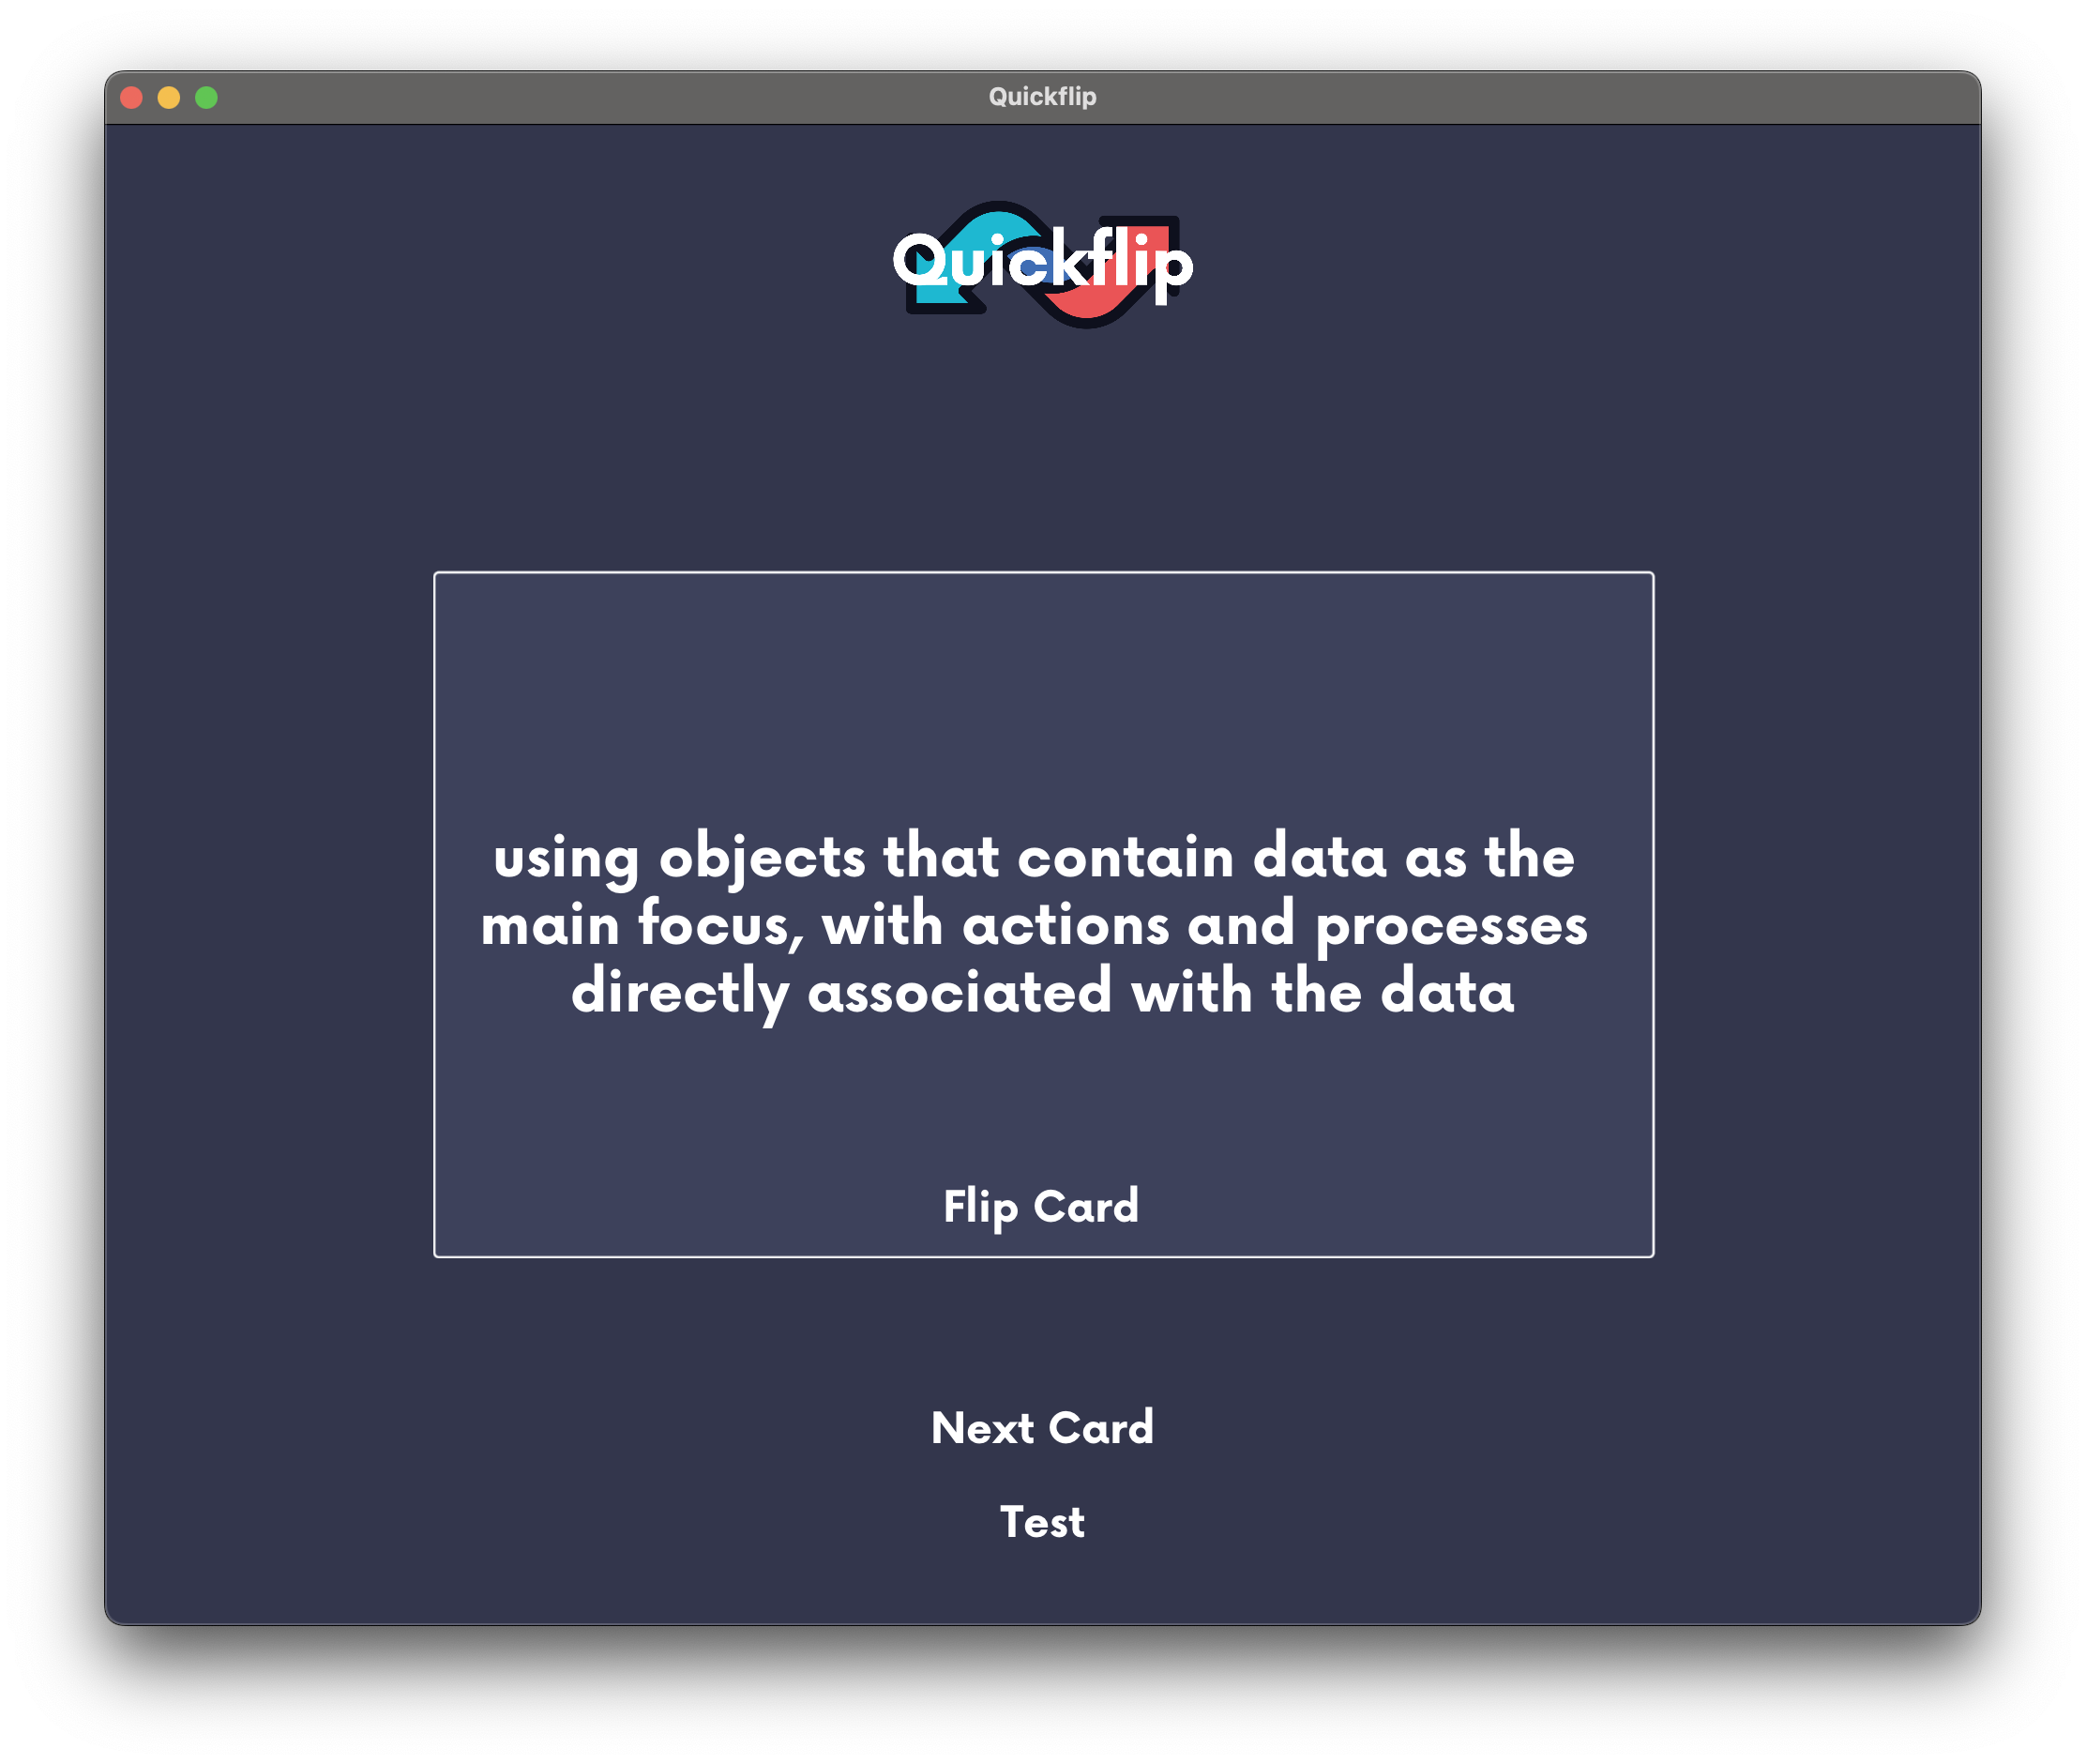
Study
Learn

Slide 7
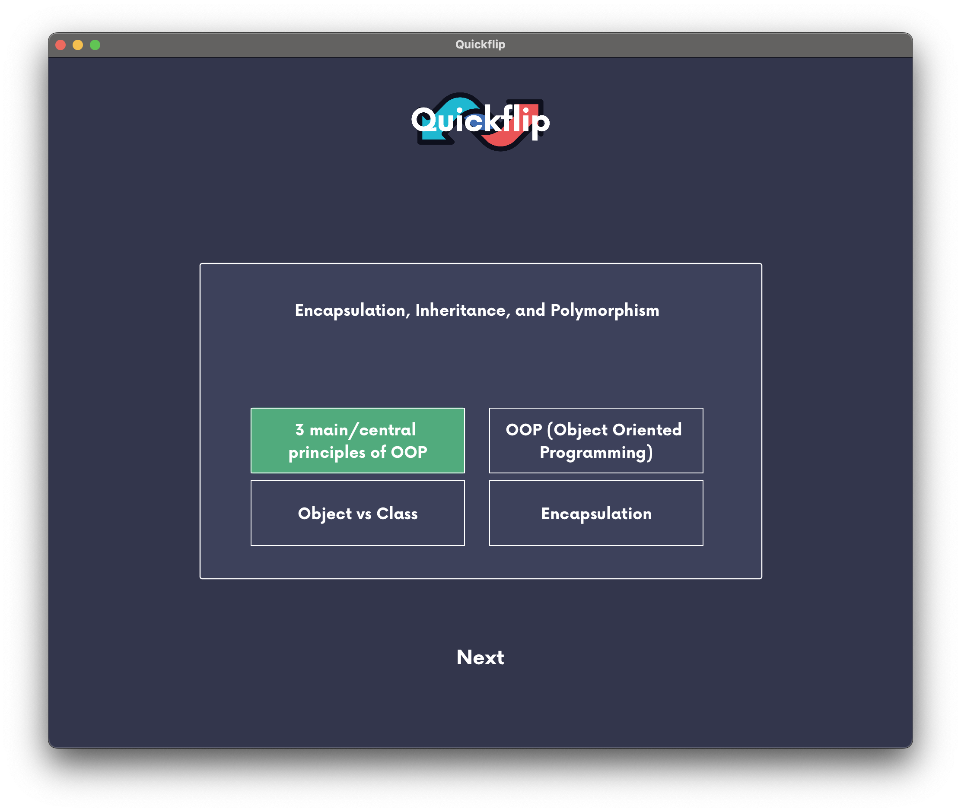
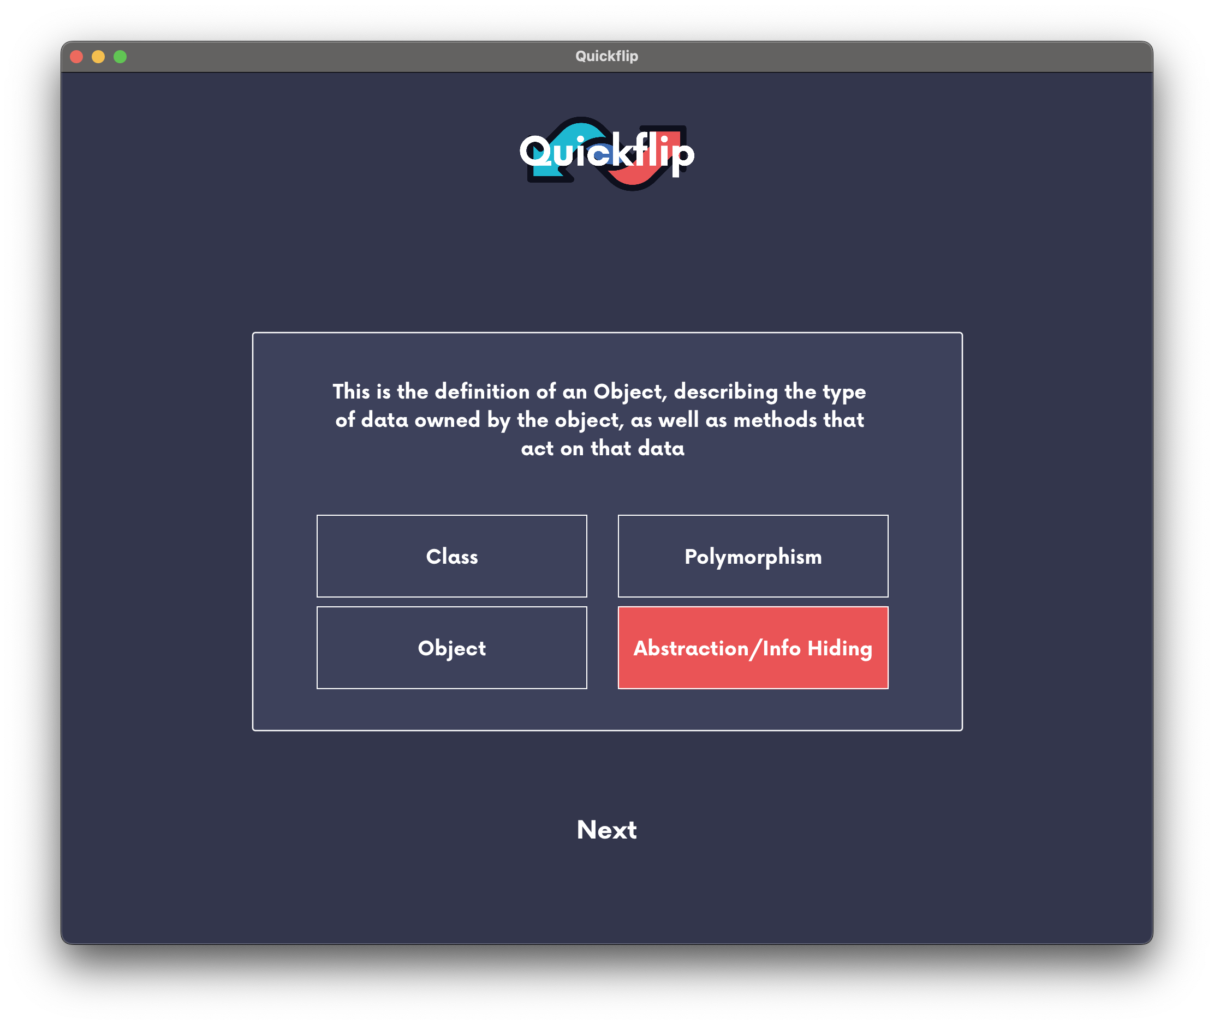
Test

Slide 8
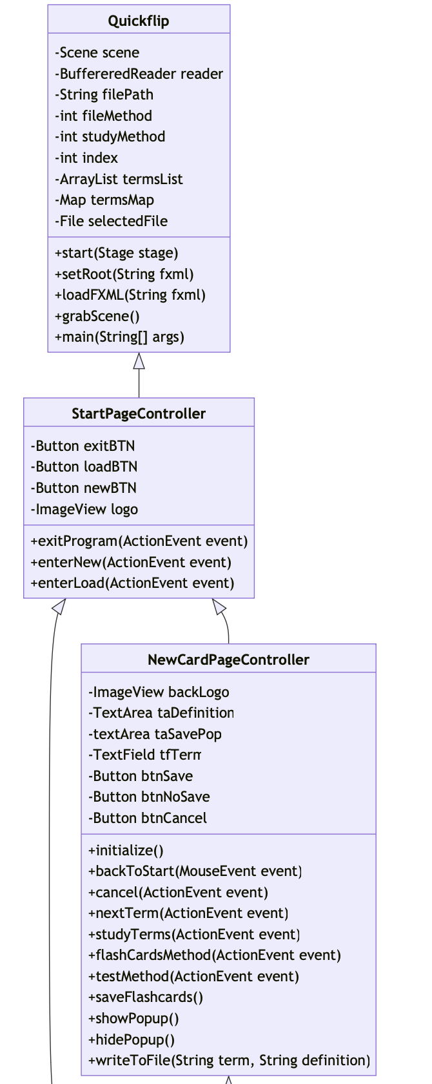
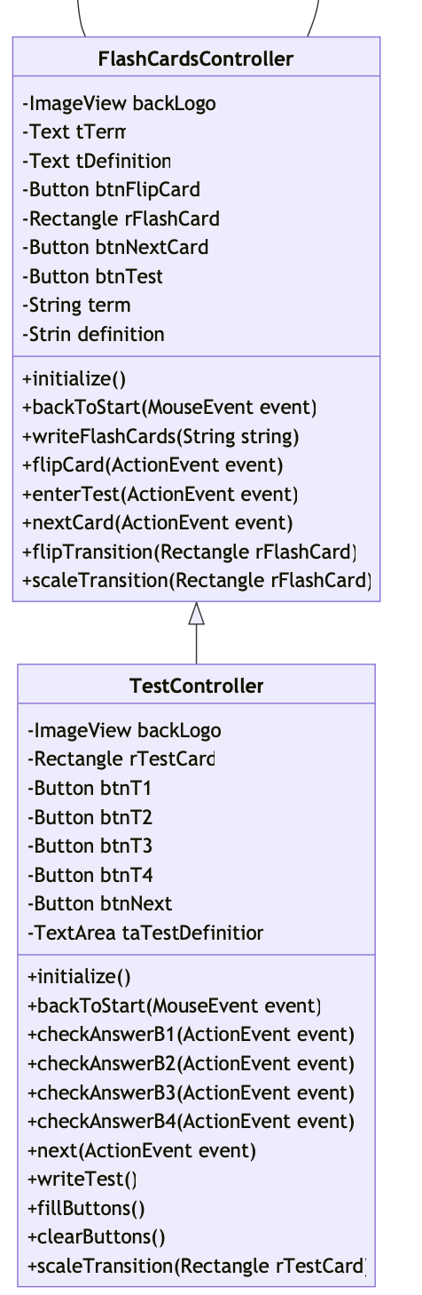

Slide 9
Lessons Learned
JavaFX
Scene Builder
Maps
Writing & Loading Files
Instance Variables

